Slide 1
ML
US National Flight Delays January-June 2024

Slide 2

INTRO
CONTEXT
One of the biggest frustrations these days is flight delays at the airports. In the following analysis we will try to answer these questions with information on US domestic flights between January-June 2024
Predict the current arrival time of flights, and with this we will be able to know the delay of domestic flights
OBJECTIVE
BUSINESS
IMPACT
- Help to improve flight- air connections that present a long delays
- Find inefficiencies between flights and improve customer satisfaction
- Improve airport efficiency.
- Reduce operating costs for airlines.

Slide 3
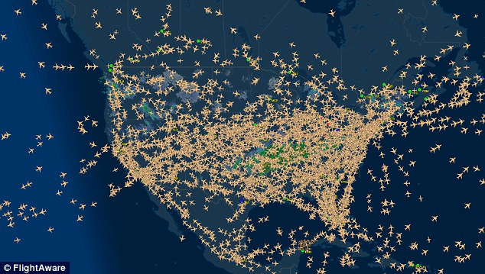
3,461,319 National flights for the period Jan-Jun 2024
336 Airports

Slide 4
1. DATA PROCESSING
In order to ensure the well-structured data in ML, transformations in raw data are needed
REMOVE UNNECESSARY COLUMS
MISSING VALUES
CONVERTING VARIABLES
We remove all those columns that we do not need for the ARR_TIME prediction.
There are 49,510 cancelled flights, with no ARR_TIME. We proceed to delete these flights as will not have delete time
For better management and optimization of the variables we will transform them into numbers
- Days of the week into numbers
Month into numbers
Cities into numbers

Slide 5
2. DATA TRANSFORM
DATA
We split the data into training and test sets
- 20% of the data will be reserved for the test
- 80% will be used for training.
Divide the into Categorical or Numerical
ORIGIN_CITY_NAME,
DEST_CITY_NAME
MONTH, DAY_OF_MONTH, DAY_OF_WEEK, CRS_DEP_TIME,
CRS_ARR_TIME

Slide 6
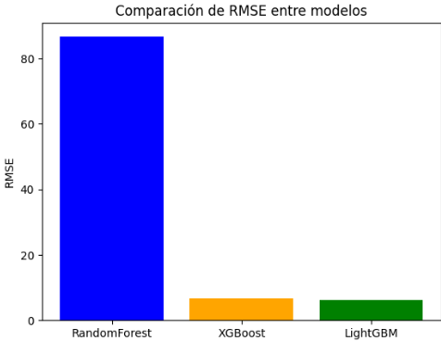
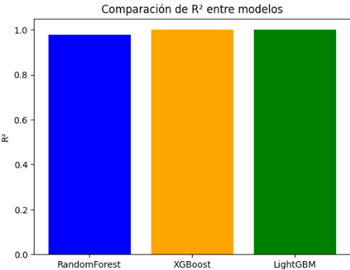
3.MODEL TRAINING
We choose to train Linear Regression, ensembles like Random Forest and boosting like XGBoost and LightGBM
- Random Forest: Tree-based ensemble method, good for noisy and non-linear data.
- XGBoost: Efficient and accurate boosting algorithm for tabular models.
LightGBM: Faster in training, especially for large datasets.
Results before optimization of the hyperparameters for the 3 models
- Random Forest is not competitive. It shows a much higher MSE than the other models, indicating that Random Forest has a worse fitting ability. It also has the smallest R²
-XGBoost has metrics that indicate an excellent fit
- LightGBM has slightly better metrics than XGBoost, making it the best model for this case.
Conclusion :LightGBM is the best model, followed closely by XGBoost, while Random Forest lags behind in comparison.

Slide 7
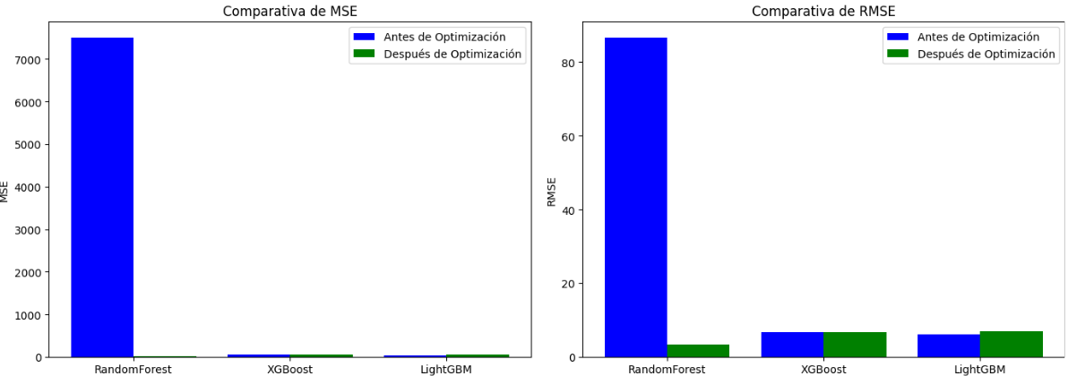
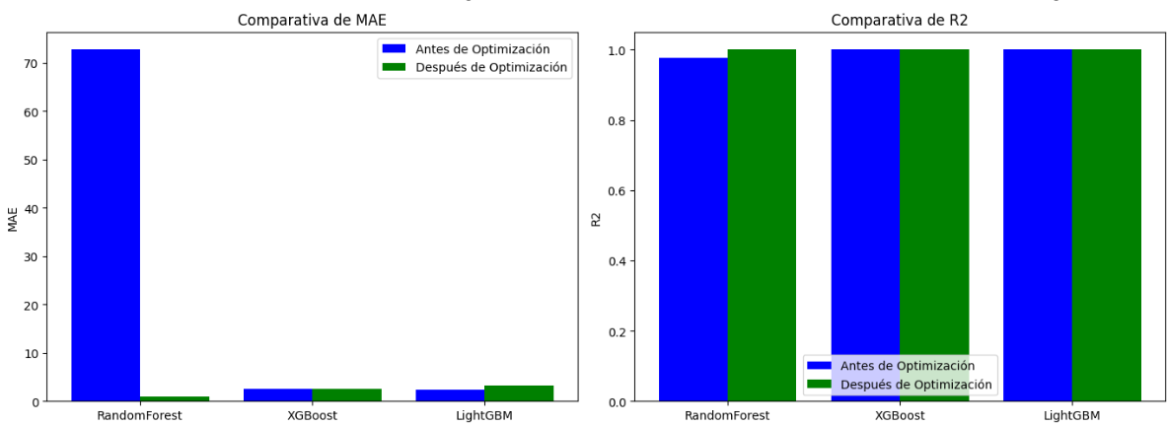
4.MODEL EVALUATE
We will evaluate the models with the best parameters found through hyperparameter optimization
- Random Forest achieves significantly better performance on all metrics after optimization compared to the default values ​​shown in the first code. Is the bhe best model among the three, with the best MSE, RMSE, MAE, and a near-perfect R².
- XGBoost is still a solid choice, but it does not outperform Random Forest on any of the metrics.
- LightGBM, while efficient, has shown somewhat inferior performance compared to XGBoost and Random Forest after optimization.
Conclusion
- Random Forest is the best model for this dataset, as it has the best performance on all key metrics after optimization.
- XGBoost is a second competitive option, but if you are looking for the most accurate model, Random Forest is the optimal choice.
- LightGBM, despite its good ability to handle large volumes of data, does not offer the best fit in this case.

Slide 8
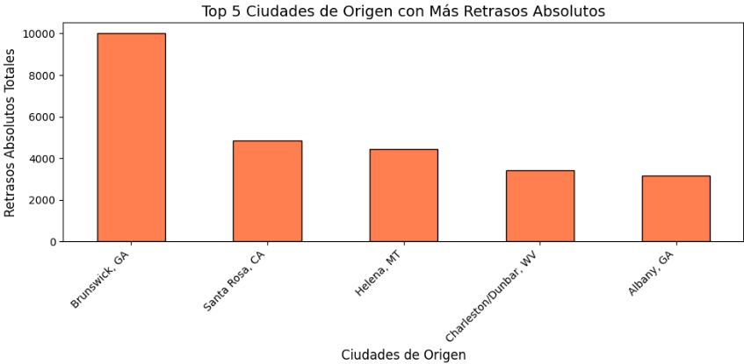
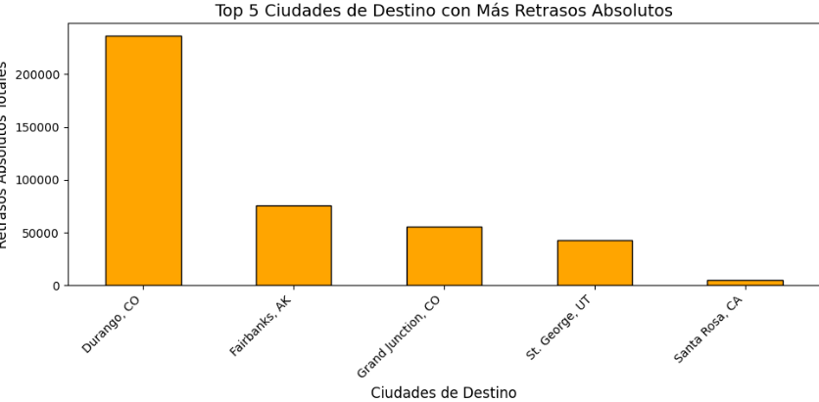
5.RESULTS
After calculating the ARR_TIME again, we will proceed to do some analysis in order to see the delays across the country.
For that analysis we will create the following columns:
-flight duration
-absolute delay
-relative delay

Slide 9

5.RESULTS
BUSINESS NEEDS
Improve flight- air connections that present a long delays
BUSINESS NEEDS
Improve airport efficiency.
BUSINESS NEEDS
Reduce flight delays
ANALYSIS RESULTS
Origin cities with significant delays :Brunswick, GA; Santa Rosa, CA; Helena, MT
- Destination cities with the highest absolute delays (e.g., Durango, CO; Fairbanks, AK; Grand Junction, CO)..
ANALYSIS RESULTS
The flight with the longest delay is Phoenix, AZ - Durango, CO
The flight with the shortest delay is Chicago, IL - New York, NY
ANALYSIS RESULTS
- The month with the most delays is February
The day of the week with the most delays is Saturday
SOLUTIONS:
- Staff Preparedness
- Winter Operations Optimization:Create contingency plans for severe weather, including backup staffing and rebooking policies.
SOLUTIONS:
Adjust schedules
Explore alternate routing:
Dedicated extra resources
SOLUTIONS:
Collaborate with Airports and Airlines in those airports.
Test alternate flight paths or scheduling adjustments for delay-heavy routes
NEXT STEPS
Dive Deep detail by airport in order to improve customer satisfaction -Analyze the specific causes of delays in February and Saturdays (e.g., winter season, staffing, maintenance).
Identify the peak times within February and Saturdays to target improvement
NEXT STEPS
- Analyze the reasons of the delays (weather, aircraft, passenger volume etc)
Perform a root-cause analysis of delays for the Phoenix-Durango route in order to improve the long delays
Analyze the success of the Chicago-New York route to identify transferable strategies to other airports.
NEXT STEPS
Identify if delays are due to external factors (e.g., weather) or internal inefficiencies

Slide 10
5.RESULTS
INFO : DELAYS POLICY IN US.
BUSINESS NEEDS
Reduce operating costs for airlines
DELAYED FLIGHTS POLICY:
The refund policy for flight delays in the U.S. varies based on the airline, as there is no federal law requiring airlines to compensate passengers for delays.
U.S. airlines are not required to offer refunds for delays unless the delay results in a significant schedule change, and the passenger chooses not to take the flight.
Some airlines may provide vouchers, meal compensation, or hotel stays for long delays (e.g., 4+ hours), but this is not universal.
For delays while on the tarmac, the Department of Transportation (DOT) mandates:Domestic flights: Passengers must be allowed to deplane after 3 hours unless it is unsafe.
International flights: The limit is 4 hours.
Airlines must provide water, snacks, and working lavatories during tarmac delays.
NEXT STEPS
Add the airline column and calculate how much money has been spent on refunds
EXAMPLES AIRLINES
American Airlines: Refunds are provided if a delay exceeds 4 hours and the passenger chooses not to travel.
- Delta Airlines: Refunds or credits are offered for delays beyond a certain threshold (varies by ticket type and delay duration).
United Airlines: Refunds are offered for "significant delays," usually defined as a delay of 6+ hours or a major schedule change.

